Slide 1
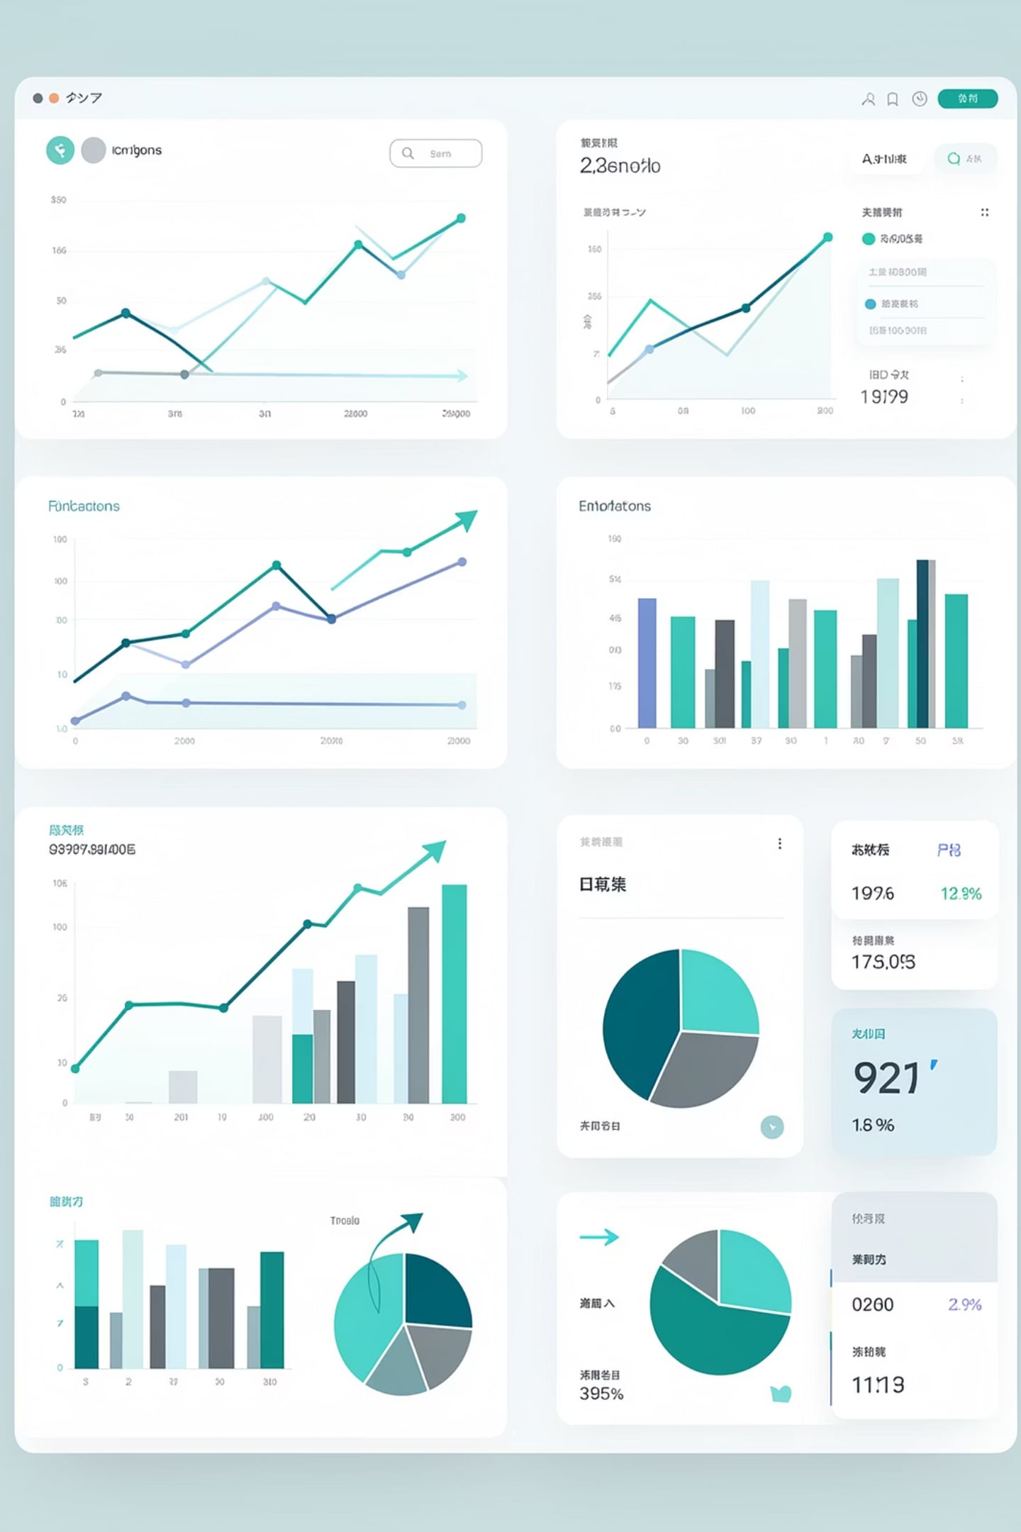
AI Mutual Fund Analyzer & Recommender System
MSc Data Science
Student: Rahul Bhagat - 24EMDT1062
Guide: Prof. Raja Das
Institution: VIT Online Learning Program
Submission Date: 10 June 2026

Slide 2
Abstract
This project presents an AI-based Mutual Fund Analyzer and Recommender System designed to help investors explore, compare, and select suitable mutual fund schemes using data-driven insights. The platform processes large-scale NAV data from Indian mutual funds to generate financial features such as returns, volatility, risk measures, momentum indicators, and trend signals.
The solution includes a RESTful FastAPI backend, an interactive Streamlit dashboard, and automated data pipelines for ingestion, preprocessing, feature engineering, ranking, and clustering. By combining financial analytics with machine learning techniques, the project reduces the complexity of mutual fund selection for retail investors, demonstrating how data science can build a practical, scalable, and user-friendly investment analysis tool.
Keywords
Mutual Fund Analysis, Financial Analytics, Machine Learning, Risk Assessment, FastAPI, Streamlit, Airflow, Python

Slide 3

Problem Statement & Motivation
The Challenge
The Solution
India has 14,341+ mutual fund schemes across 51 fund houses really impossible to manually evaluate
Investors lack objective tools to compare risk versus return across funds
There is a gap between raw AMFI data and actionable investment insights
An end-to-end platform that transforms raw AMFI data (mutual fund) into actionable recommendations through automated data pipelines, intelligent ranking algorithms, and personalized recommendations.

Slide 4
Research Design & Project Plan
1. Research Objective
Build a comprehensive mutual fund analysis platform that downloads NAV data, cleans it, engineers financial features, and exposes results through API and interactive dashboard.
Enable data-driven decision support for Indian mutual fund investors.
2. Sampling Plan
Population: Indian mutual fund schemes available in AMFI NAV data.
Data Source: AMFI NAV file (NAVAll.txt) - official regulatory source.
Raw Sample Size: 14,341 schemes across 51 fund houses.
Cleaned Sample Size: 11,506 schemes (19.77% removed due to data quality issues).
Featured Sample Size: 1,874 schemes with complete engineered metrics.
Sampling Strategy: Census approach (all available schemes) rather than random sampling.
3. Tools & Technologies Identified
Library / Tool
Purpose
Specific Use in Project
Pandas
Data manipulation and cleaning
Used throughout for reading CSVs, cleaning data, building DataFrames, handling missing values, and performing data transformations. Implemented in main.py, data_cleaning.py, and utils.py.
NumPy
Numerical computing
Used for numeric operations, NaN handling, scaling helpers, array operations, and feature calculations. Implemented in feature_engineering.py, main.py, and recommendation.py.
SciPy
Scientific computing
Listed as a dependency for advanced statistical operations and mathematical functions. Not actively used in the current implementation, but available for future enhancements.
Scikit-Learn
Machine learning library
Used for K-Means clustering, StandardScaler normalization, and the NearestNeighbors recommendation engine. Implemented in clustering.py and recommendation.py.
Plotly
Interactive visualizations
Used heavily for interactive charts, 3D scatter plots, and financial visualizations in the Streamlit dashboard. Implemented in app.py, Scheme_Search.py, and ML_Clusters.py.
FastAPI
API development framework
Used to build REST endpoints for scheme data access, recommendations, and analytics services.
Streamlit
Interactive dashboard framework
Used to create the user-facing dashboard for exploring mutual fund insights and model outputs.
Apache Airflow
Workflow orchestration
Used to schedule and automate data pipelines through DAGs.
Docker
Containerization
Used to package the application for deployment in a consistent runtime environment.
PostgreSQL 15 [Future Enhancement ]
Relational database
Used for storage of cleaned scheme data and engineered outputs.
4. Project Milestones & Timeline
Week
Milestone
Description
Week 1
Data Collection & Ingestion
AMFI NAV download, parsing, initial validation
Week 2
Data Cleaning & Validation
Outlier removal, IQR filtering, date validation
Week 3
Feature Engineering
17 financial metrics computation, data normalization
Week 4
API Development
FastAPI endpoints, testing, documentation
Week 5
Dashboard & Workflow Automation
Streamlit UI, Airflow DAGs, integration
Week 6
Testing, Deployment & Documentation
End-to-end testing, Docker deployment, final documentation

Slide 5
Literature Review & Theoretical Background
A concise overview of the key literature and financial theories informing our mutual fund analysis and recommendation system.
2.1 Mutual Fund Performance Evaluation
Markowitz Modern Portfolio Theory: establishes the risk-return tradeoff as the foundation for portfolio evaluation.
Sharpe Ratio: measures excess return per unit of total volatility.
Sortino Ratio: focuses on downside deviation and penalizes harmful risk more directly.
2.2 Financial Data Engineering
AMFI data quality: NAVAll.txt requires cleaning for missing values, date consistency, and scheme-level validation.
Feature extraction: transforms raw NAV histories into usable indicators for analysis and recommendation.
Technical indicators: moving averages, RSI, volatility, and crossover signals support structured financial analytics.
2.3 Machine Learning Applications
K-Means clustering: groups mutual funds into performance-based segments for comparison and screening..
Decision support: combines statistical features and learned patterns to improve fund selection.
2.4 Interactive Financial Frameworks
FastAPI: provides a fast, scalable backend for serving analytics and recommendations.
Streamlit: enables an accessible interactive dashboard for exploration and comparison.
Democratization: turns complex mutual fund analytics into a practical tool for everyday investors and researchers.

Slide 6






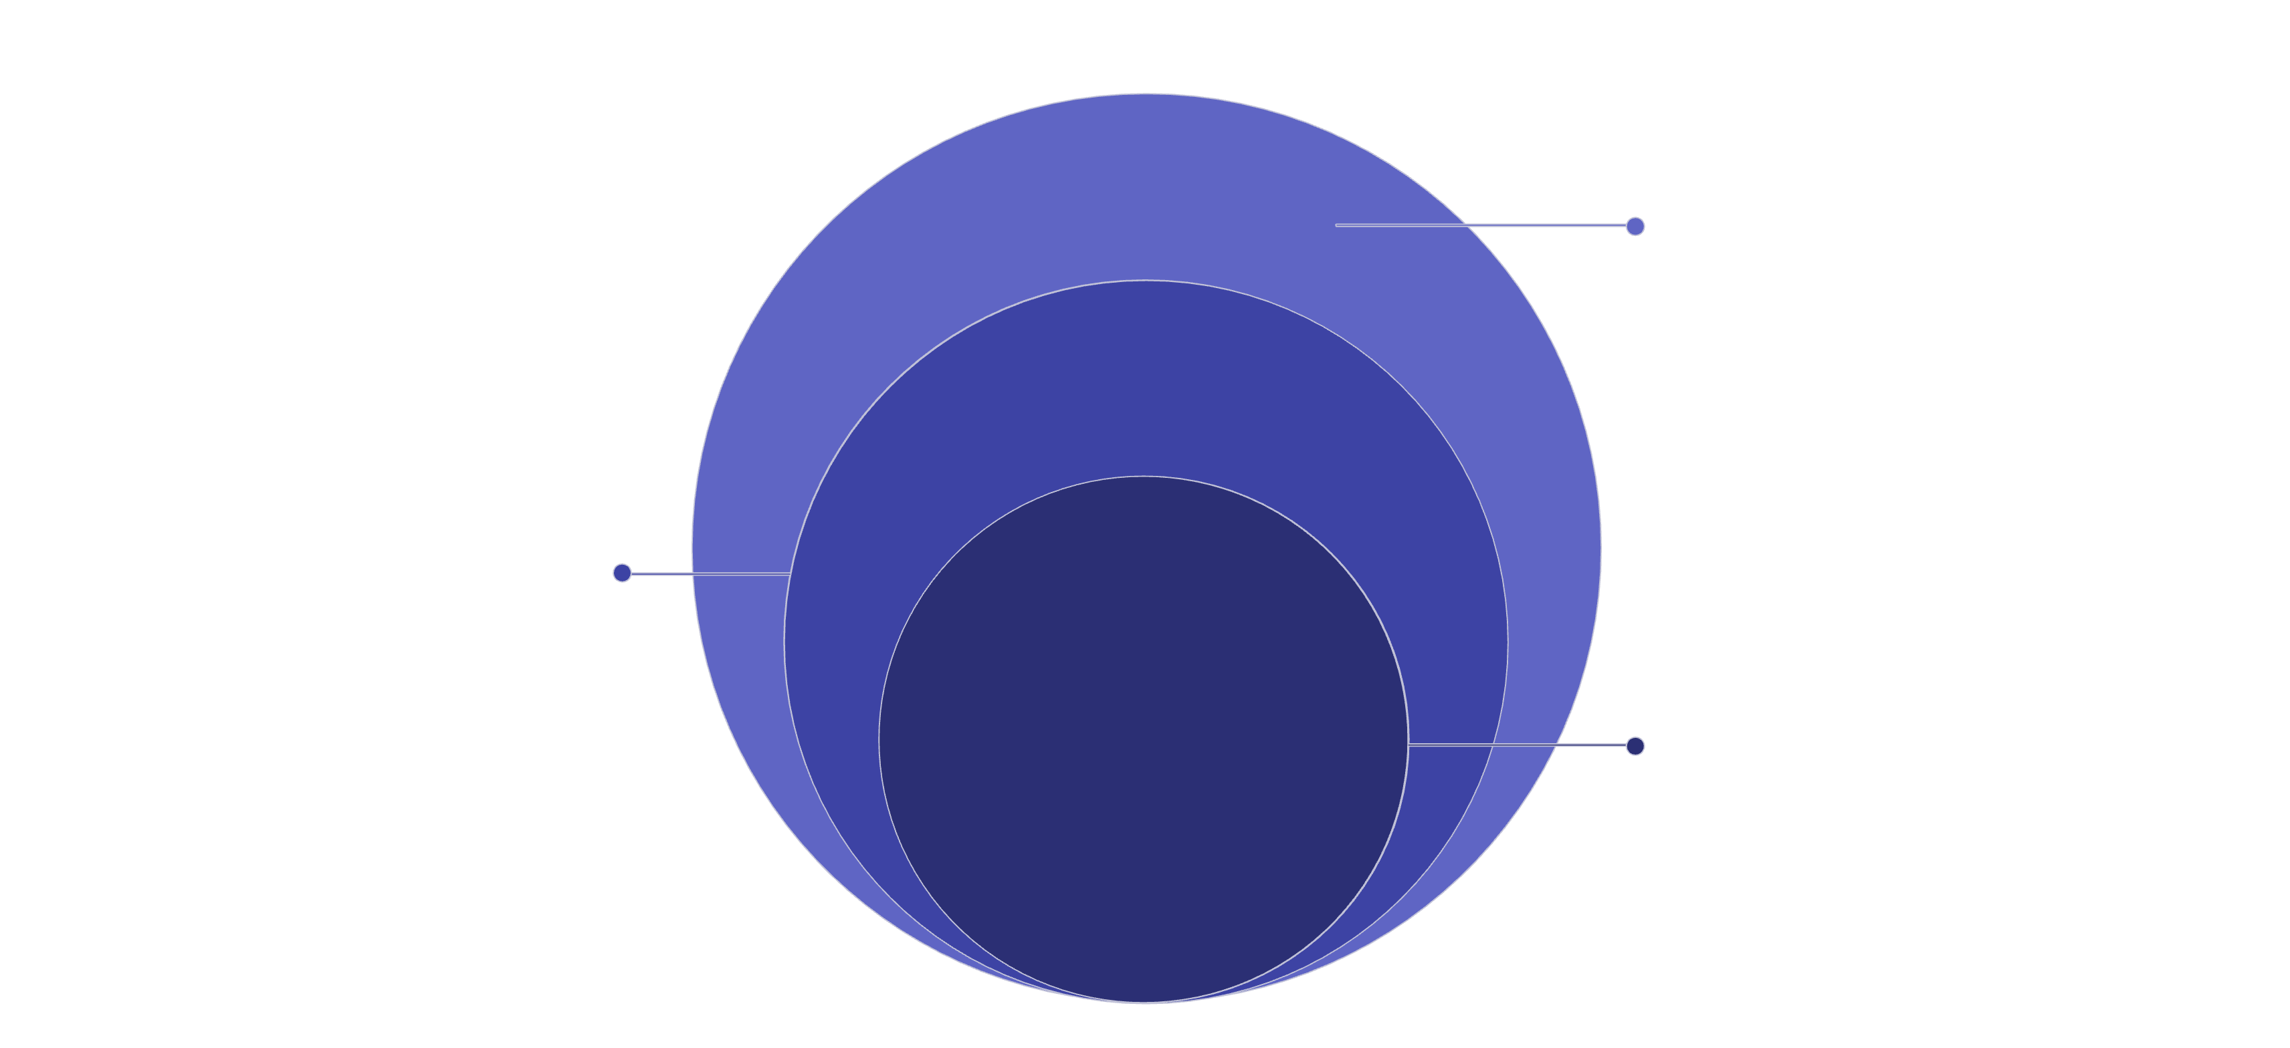
System Architecture
Storage & Context Layer
ETL Pipeline Layer
PostgreSQL 15 | In-Memory Cache (NOW)
Data Source Layer
Ingestion, Cleaning, Feature Engineering
AMFI NAVAll.txt | 14,341 schemes
UI Layer
API Service Layer
Streamlit | dashboard
Machine Learning Engine
FastAPI | REST endpoints
K-Means (K=4), Multi-Factor Ranking, Personalized Recommendation
ML, API & UI
K-Means K=4, ranking; FastAPI endpoints; Streamlit dashboard
ETL & Storage
Ingestion, cleaning, feature engineering; PostgreSQL 15 & cache
Data Source
AMFI NAVAll.txt — 14,341 schemes

Slide 7
Machine Learning Overview
The machine learning component of this project is designed as an interpretable, calculation-driven pipeline for mutual fund analysis. It transforms raw NAV time-series data into structured financial signals, groups similar schemes, and produces transparent recommendations aligned with investor risk profiles.
Stage 1: Deterministic Feature Engineering
Raw NAV data is converted into financial indicators such as moving averages, volatility, Sharpe ratio, maximum drawdown, RSI, and trend strength. These engineered metrics form a structured feature space that represents each fund in a consistent, auditable way.
Stage 2: K-Means Clustering
The system applies K-Means clustering with K = 4 to group schemes with similar risk-return characteristics. This creates interpretable clusters that help organize funds into comparable categories.
Stage 3: Multi-Factor Scoring & Recommendation
Finally, multi-factor scoring and nearest-neighbor based matching are used to rank and recommend schemes according to investor risk profiles. This stage translates the feature space and cluster structure into actionable fund recommendations.
Key Advantage
The output remains transparent, auditable, and directly traceable to underlying financial calculations rather than relying on a black-box model. Every recommendation can be inspected and validated from the original NAV series through to the final ranking.

Slide 8
ML Implementation & Execution
1. Implementation Architecture
The ML Engine runs independently of the data collection process, pulling data from the excel to extract deeper, automated insights through a three-stage sequence: k-Means Clustering, Multi-Factor Ranking, and Personalized Recommendation. This modular design ensures the analytics can be updated without disrupting the data ingestion pipeline.
2. Step-by-Step Execution Example
01
02
Step 1: Input Raw Historical Data
Step 2: Feature Engineering Metrics Generation
An anonymous Growth Mutual Fund starts with a Starting NAV of \text{₹}100.00 and an Ending NAV of \text{₹}125.00 over a specific period. The Risk-Free Rate is 6.0\%.
From the raw NAV history, key financial metrics are calculated:
Total Return: 25.0\%
Annualized Volatility: 12.0\%
Sharpe Ratio: 1.5833
Sortino Ratio: 2.1050
Maximum Drawdown: -4.5\%
Trend Strength: 78.50
03
04
Step 3: Normalization & K-Means Partitioning
Step 4: Utility Score Calculation and Recommendation Evaluation
The engineered features are normalized using StandardScaler. The fund's feature vector is then compared using Euclidean distance to existing cluster centroids and assigned to
Cluster 2: Moderate Growth based on its proximity to that cluster's center.
For an investor with a Moderate Risk Profile (\lambda=1.0), the utility score is calculated as:
Plugging in the values: Utility = 0.25 + 1.0 \times (1.5833 + 2.1050 - 0.12 - (-0.045) + 0.7850)
This results in a final utility score of 20.7416.
3. Real-Time Recommendation
The backend service continuously calculates utility scores for all eligible funds based on the latest data and selected investor risk profile. These funds are then sorted in descending order of their utility scores, allowing the top-performing schemes to be displayed dynamically on the dashboard leaderboard.

Slide 9
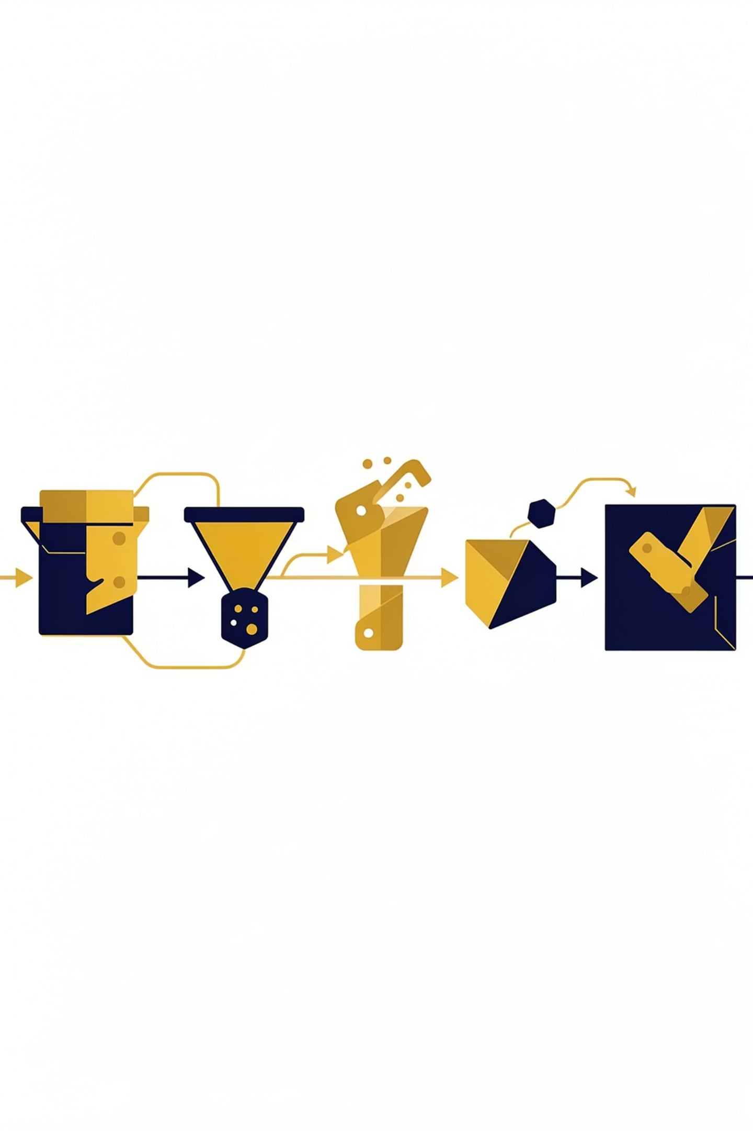
Data Pipeline
01
02
DAG 1: Fetch / Ingest
DAG 2: Validate / Clean
Download AMFI data from a 1.8MB semicolon-delimited NAV file.
14,341 raw schemes
Apply IQR filter, remove zero/negative NAV, and fix invalid dates.
11,506 clean schemes (19.77% removed)
03
04
DAG 3: Feature Engineering
DAG 4: ML Clustering
Compute 17 financial metrics per scheme for model readiness.
1,874 featured schemes
Run K-Means to group schemes by risk-return profile.
05
06
DAG 5: ML Ranking
DAG 6: Master Orchestration
Apply composite scoring to rank schemes within each cluster.
Coordinate the end-to-end Airflow pipeline and downstream outputs.
Data flow: 14,341 raw → 11,506 cleaned → 1,874 featured schemes

Slide 10




17 Engineered Financial Metrics
Trend Metrics
Risk Metrics
Direction and smoothness of price movement over time.
Variability and downside risk carried by the asset.
SMA 50: 50-day simple moving average
SMA 200: 200-day simple moving average
EMA 12: 12-day exponential moving average
EMA 26: 26-day exponential moving average
Annualized Volatility: Standard deviation of returns scaled to a year
Sharpe Ratio: Risk-adjusted return relative to total volatility
Sortino Ratio: Risk-adjusted return focused on downside volatility
Maximum Drawdown: Largest peak-to-trough decline
Momentum Metrics
Return Metrics
Strength and speed of recent price moves.
Value generated over different time horizons.
RSI: Relative strength index showing overbought or oversold conditions
Trend Strength: Score indicating how strongly price is trending
Total Return: Overall gain or loss across the full period
Cumulative Return: Compounded growth over time
Daily Return: One-day percentage change in price or NAV

Slide 11
FastAPI
FastAPI is the backend routing microservice that enables high-throughput asynchronous performance for the platform.
API Details
Core Endpoints
15+ secure REST endpoints
Pydantic structures for data validation
Redis caching for sub-100ms response times
Async execution with Uvicorn
GET /api/schemes/{scheme_code} — Full scheme analytics
GET /api/ml/recommendations — Personalized recommendations
GET /api/schemes — All schemes
GET /api/schemes/search — Search schemes
GET /api/compare — Side-by-side comparison
GET /api/top-schemes — Ranked leaderboard

Slide 12
Dashboard (Streamlit)
An 8-page interactive analytical web application, completely decoupled from the database and ML engines.
Dashboard Overview
Main Pages
URL: http://localhost:8501
Interactive Plotly visualizations with JSON payload rendering
Built for fast exploration, comparison, and model-driven insights
Dashboard — market overview
Scheme Search — wildcard text patterns
Comparison Engine — time-series metrics
ML Clusters Visualizer — 3D scatter topologies
ML Rankings — leaderboard
ML Recommendations — risk profile matching

Slide 13
Real-World Impact and Applications
For Retail Investors:
For Fund Managers & Asset Houses:
Democratized Access: Eliminates reliance on expensive financial advisors by providing institutional-grade analysis at zero cost
Data-Driven Decisions: Replaces subjective advice with transparent, verifiable financial metrics (Sharpe ratio, volatility, drawdown)
Risk Alignment: Personalized recommendations matching individual risk tolerance (Low/Moderate/High profiles)
Time Savings: Reduces fund selection from hours of manual research to minutes of interactive dashboard exploration
Competitive Benchmarking: Real-time clustering reveals peer performance and market positioning
Product Development: Identifies market gaps in risk-return segments for new fund launches
Performance Tracking: Continuous monitoring of fund behavior against engineered metrics
Investor Communication: Transparent ranking methodology builds trust and reduces redemptions
For Financial Institutions:
Industry Impact:
Scalable Infrastructure: Production-ready API enables white-label integration into existing platforms
Cost Efficiency: Automated ETL pipeline reduces manual data processing by 95%
Regulatory Compliance: Audit trail of all calculations ensures transparency for SEBI/RBI requirements
Market Intelligence: Clustering insights inform portfolio construction and risk management strategies
Bridges information asymmetry in Indian mutual fund market, enabling 500M+ retail investors to make informed decisions aligned with their financial goals.

Slide 14

Limitations & Future Enhancements
Current System Limitations
Future Enhancement Roadmap
Fixed Cluster Cardinality (K=4)
Q3 2026 : Integrate AI and fully automated pipelines
Dynamic clustering with Silhouette-based K optimization
Portfolio construction module with correlation analysis
Q1 2027: Tax-adjusted return calculations and goal-based recommendations
Q2 2027: Mobile app deployment and real-time push notifications
Q3 2028: International fund support and multi-currency analysis
System partitions funds into 4 preset risk categories
Does not use automated optimization (Elbow Method, Silhouette Score) to adjust clusters dynamically
Future: Implement dynamic K-selection based on market volatility
Lack of Portfolio Optimization
Evaluates funds individually without cross-asset correlation analysis
Does not use Markowitz Mean-Variance Optimization for diversified basket construction
Future: Add portfolio-level optimization with correlation matrices
Data History Dependency
Cannot analyze newly launched funds (NFOs) lacking historical NAV records and AFMI doesn't have full data.
Requires minimum 1-year data window for reliable metric calculation
Future: Implement hybrid approach combining peer-group analysis for new launches
Single Upstream Dependency
Tightly coupled to AMFI data portal; any schema changes disrupt ingestion
No fallback data sources or redundancy mechanisms
Future: Multi-source data aggregation with fallback providers
Recommendation Scope
Focuses on Indian mutual funds only; no international asset class support
Does not account for tax implications or investor-specific constraints
Future: Tax-adjusted returns, goal-based filtering, SIP optimization

Slide 15
Performance Metrics & Conclusion
14,341
11,506
Schemes Processed
Cleaned Schemes
From 51 fund houses
19.77% removed
1,874
<100ms
Featured Schemes
Avg API Response
With 17 metrics
Sub-100 milliseconds
4
6
Risk Clusters
Airflow DAGs
K-Means K=4
Orchestrating the pipeline
15+
8
REST Endpoints
Page Dashboard
API coverage validated
Interactive analytics interface
Key Achievements
Complete 5-layer architecture
15+ REST endpoints tested
8-page interactive dashboard
Automated Airflow pipeline
100% data validation pass rate
Production-ready deployment
Scalable ML components
Comprehensive documentation
Conclusion
This project bridges the gap between complex financial data and practical investment decision-making by transforming raw AMFI inputs into clean, structured, and actionable intelligence for Indian mutual fund analysis.

Slide 16
References
[1] Markowitz, H. (1952). Portfolio Selection. The Journal of Finance, 7(1), 77-91. https://doi.org/10.1111/j.1540-6261.1952.tb01525.x
[2] Sharpe, W. F. (1966). Mutual Fund Performance. The Journal of Business, 39(1), 119-138.
[3] Sortino, F. A., & van der Meer, H. J. (1991). Downside Risk. The Journal of Portfolio Management, 17(4), 27-31. https://doi.org/10.3905/jpm.1991.409343
[4] MacQueen, J. (1967). Some Methods for Classification and Analysis of Multivariate Observations. In Proceedings of the Fifth Berkeley Symposium on Mathematical Statistics and Probability (Vol. 1, pp. 281-297).
[5] FastAPI Developers. (2024). FastAPI Framework: Asynchronous High-Performance Web APIs in Python. https://fastapi.tiangolo.com
[6] Association of Mutual Funds in India (AMFI). (2026). Mutual Fund Net Asset Value (NAV) Data Portal. https://www.amfiindia.com

Slide 17
Thank You
Questions & Discussion
For inquiries, feedback, or collaboration opportunities:
📧 Email: rahul.bhagat@vit.ac.in
🔗 GitHub: Project Repository
📊 Dashboard: Live Demo Link

